Slide 1
Backpropagation

Slide 2
Gradient Descent Considerations
We still need to calculate the derivatives.
We need to set the learning rate.
Local vs global minima.
The full likelihood function includes summing up all individual ‘errors’. Sometimes this includes hundreds of thousands of examples.

Slide 3
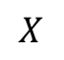

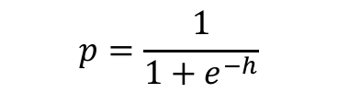
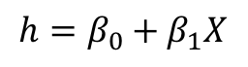
Logistic Regression Revisited
Affine
Activation
Loss Fun
$$ℒ(β)=\sum_{i}^{n}{ℒ_{i}\left(β\right)}$$
$$p=\frac{1}{1+e^{−h}}$$
$$X$$
$$h=β_{0}+β_{1}X$$

Slide 4
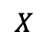
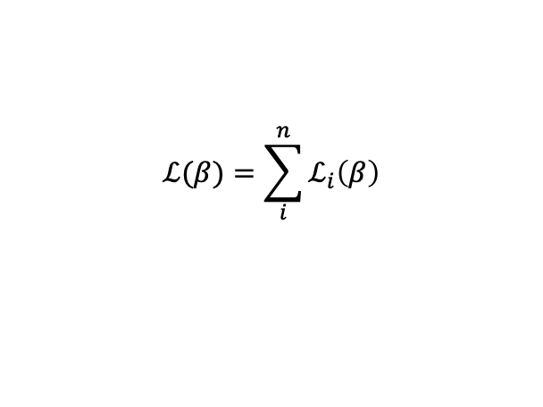
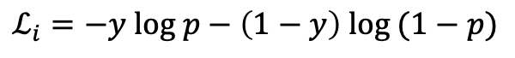
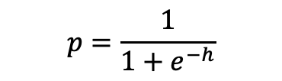
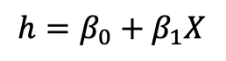
Logistic Regression Revisited
$$ℒ_{i}=−y log p−\left(1−y\right) log (1−p)$$
Affine
Activation
Loss Fun
$$ℒ(β)=\sum_{i}^{n}{ℒ_{i}\left(β\right)}$$
$$p=\frac{1}{1+e^{−h}}$$
$$X$$
$$h=β_{0}+β_{1}X$$

Slide 5
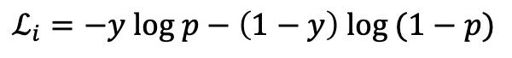
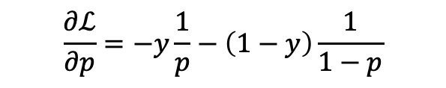
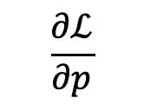
Logistic Regression Revisited
$$ℒ_{i}=−y log p−\left(1−y\right) log (1−p)$$
Affine
Activation
Loss Fun
$$ℒ(β)=\sum_{i}^{n}{ℒ_{i}\left(β\right)}$$
$$p=\frac{1}{1+e^{−h}}$$
$$X$$
$$h=β_{0}+β_{1}X$$
$$\frac{∂ℒ}{∂p}$$
$$\frac{∂ℒ}{∂p}=−y\frac{1}{p}−\left(1−y\right)\frac{1}{1−p}$$

Slide 6
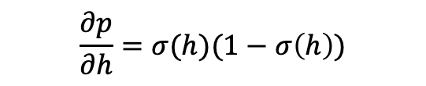
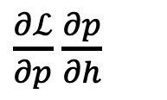
Logistic Regression Revisited
$$ℒ_{i}=−y log p−\left(1−y\right) log (1−p)$$
Affine
Activation
Loss Fun
$$ℒ(β)=\sum_{i}^{n}{ℒ_{i}\left(β\right)}$$
$$p=\frac{1}{1+e^{−h}}$$
$$X$$
$$h=β_{0}+β_{1}X$$
$\frac{∂ℒ}{∂p}$ $\frac{∂p}{∂h}$
$$\frac{∂ℒ}{∂p}$$
$$\frac{∂p}{∂h}=σ(h)(1−σ\left(h\right))$$
$$\frac{∂ℒ}{∂p}=−y\frac{1}{p}−\left(1−y\right)\frac{1}{1−p}$$

Slide 7
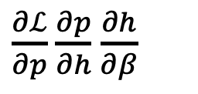
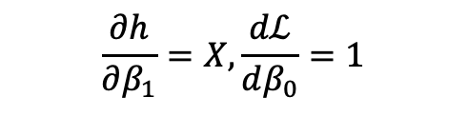
Logistic Regression Revisited
$$ℒ_{i}=−y log p−\left(1−y\right) log (1−p)$$
Affine
Activation
Loss Fun
$$ℒ(β)=\sum_{i}^{n}{ℒ_{i}\left(β\right)}$$
$$p=\frac{1}{1+e^{−h}}$$
$$X$$
$$h=β_{0}+β_{1}X$$
$\frac{∂ℒ}{∂p}$ $\frac{∂p}{∂h}$ $\frac{∂h}{∂β}$
$\frac{∂ℒ}{∂p}$ $\frac{∂p}{∂h}$
$$\frac{∂ℒ}{∂p}$$
$$\frac{∂h}{∂β_{1}}=X,\frac{dℒ}{dβ_{0}}=1$$
$$\frac{∂p}{∂h}=σ(h)(1−σ\left(h\right))$$
$$\frac{∂ℒ}{∂p}=−y\frac{1}{p}−\left(1−y\right)\frac{1}{1−p}$$

Slide 8
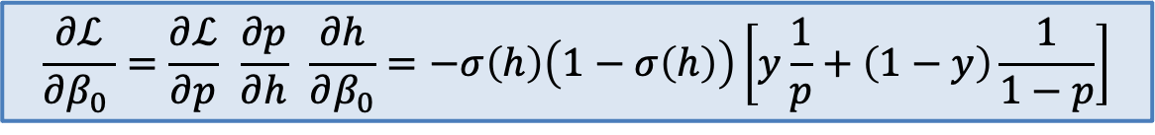
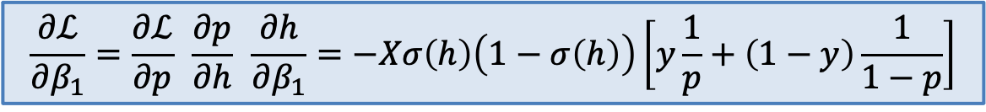
Logistic Regression Revisited
$$ℒ_{i}=−y log p−\left(1−y\right) log (1−p)$$
Affine
Activation
Loss Fun
$$ℒ(β)=\sum_{i}^{n}{ℒ_{i}\left(β\right)}$$
$$p=\frac{1}{1+e^{−h}}$$
$$X$$
$$h=β_{0}+β_{1}X$$
$\frac{∂ℒ}{∂p}$ $\frac{∂p}{∂h}$ $\frac{∂h}{∂β}$
$\frac{∂ℒ}{∂p}$ $\frac{∂p}{∂h}$
$$\frac{∂ℒ}{∂p}$$
$$\frac{∂h}{∂β_{1}}=X,\frac{dℒ}{dβ_{0}}=1$$
$$\frac{∂p}{∂h}=σ(h)(1−σ\left(h\right))$$
$$\frac{∂ℒ}{∂p}=−y\frac{1}{p}−\left(1−y\right)\frac{1}{1−p}$$
$$\frac{∂ℒ}{∂β_{1}}=\frac{∂ℒ}{∂p} \frac{∂p}{∂h} \frac{∂h}{∂β_{1}}=−Xσ\left(h\right)\left(1−σ\left(h\right)\right)\left[y\frac{1}{p}+\left(1−y\right)\frac{1}{1−p}\right]$$
$$\frac{∂ℒ}{∂β_{0 }}=\frac{∂ℒ}{∂p} \frac{∂p}{∂h} \frac{∂h}{∂β_{0}}=−σ\left(h\right)\left(1−σ\left(h\right)\right)\left[y\frac{1}{p}+\left(1−y\right)\frac{1}{1−p}\right]$$

Slide 9
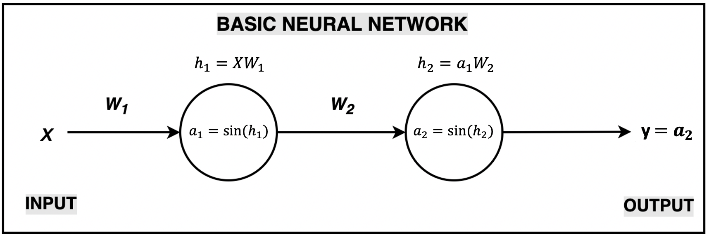
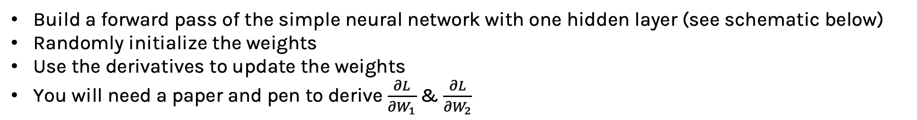
Exercise: Back-propagation by hand The aim of this exercise is to perform back-propagation to update the weights of a simple neural network
Build a forward pass of the simple neural network with one hidden layer (see schematic below)
Randomly initialize the weights
Use the derivatives to update the weights
You will need a paper and pen to derive $\frac{∂L}{{∂W}_{1}}$ & $\frac{∂L}{{∂W}_{2}}$

Slide 10
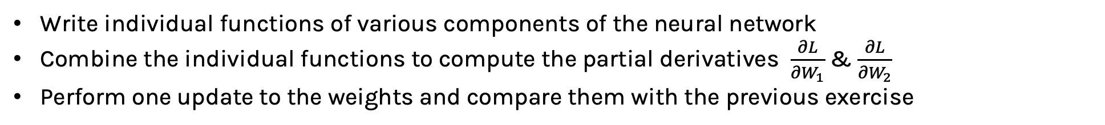
Exercise: Back-propagation by chain rule The aim of this exercise is to understand how chain rule works using the same simple neural network from the previous exercise
Write individual functions of various components of the neural network
Combine the individual functions to compute the partial derivatives $\frac{∂L}{{∂W}_{1}}$ & $\frac{∂L}{{∂W}_{2}}$
Perform one update to the weights and compare them with the previous exercise

Slide 11
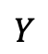
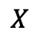
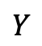
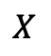
Derivatives need to be evaluated at some values of X, y, and Ws.
But since we have an expression for the derivative, we can build a function that takes as input X, y, W, and returns the derivatives, and then we can use gradient descent to update.
This approach works well, but it does not generalize. For example, if the network is changed, we need to write a new function to evaluate the derivatives.
$$X$$
$$Y$$
$$X$$
$$Y$$
These two networks have different derivatives. We need a mechanism, so we do not need to re-code the derivatives.

Slide 12
Derivatives need to be evaluated at some values of X, y, and Ws.
But since we have an expression for the derivative, we can build a function that takes as input X, y, W, and returns the derivatives, and then we can use gradient descent to update.
This approach works well, but it does not generalize. For example, if the network is changed, we need to write a new function to evaluate the derivatives.
These two networks have different derivatives. We need a mechanism, so we do NOT need to re-code the derivatives.
$$X$$
$$Y$$
$$X$$
$$Y$$

Slide 13
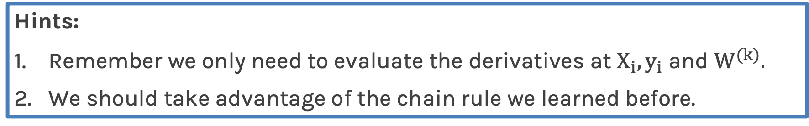
Backpropagation (cont.)
Need to find a formalism to calculate the derivatives of the loss w.r.t. weights that is:
flexible enough that adding a node or a layer or changing something in the network will not require re-deriving the functional form from scratch.
it is exact.
it is computationally efficient.
Hints:
Remember we only need to evaluate the derivatives at $X_{i}, y_{i}$ and $W^{(k)}.$
We should take advantage of the chain rule we learned before.

Slide 14
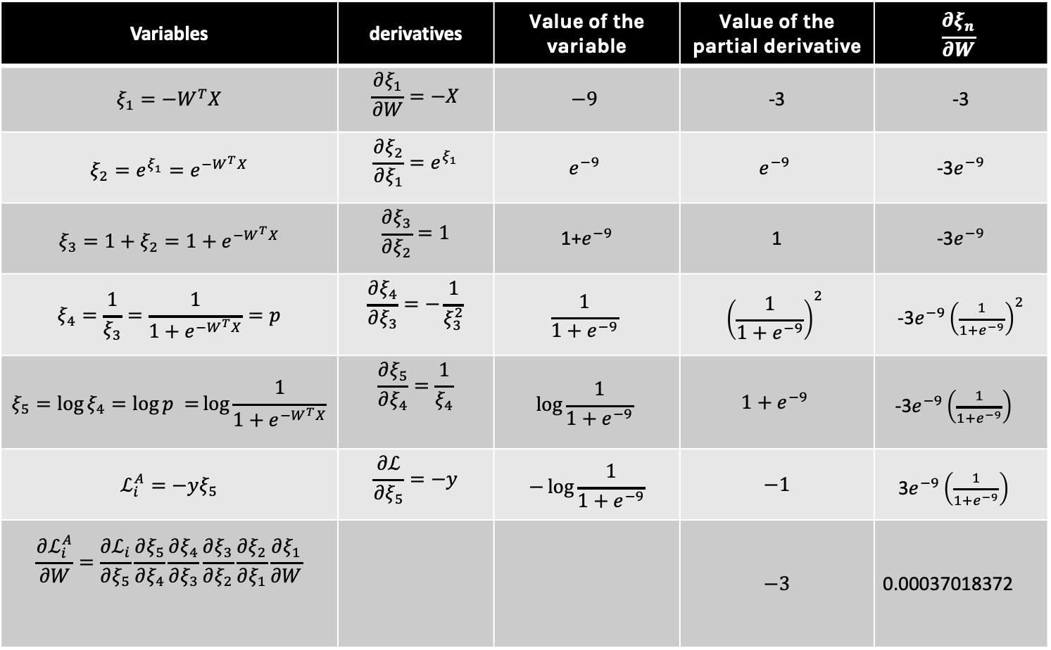
For example, for input X={3}, y=1 and weight W=3, we evaluate the values of the variables, partial derivatives and the chain up to this point as shown below
Variables | derivatives | Value of the variable | Value of the partial derivative | $$\frac{∂ξ_{n}}{∂W}$$
$$ξ_{1}=−W^{T}X$$ | $$\frac{∂ξ_{1}}{∂W}=−X$$ | $$−9$$ | -3 | -3
$$ξ_{2}={e^{ξ_{1}}=e}^{−W^{T}X}$$ | $$\frac{∂ξ_{2}}{∂ξ_{1}}=e^{ξ_{1}}$$ | $$e^{−9}$$ | $$e^{−9}$$ | -3$e^{−9}$
$$ξ_{3}=1+ξ_{2}=1+e^{−W^{T}X}$$ | $$\frac{∂ξ_{3}}{∂ξ_{2}}=1$$ | 1+$e^{−9}$ | 1 | -3$e^{−9}$
$$ξ_{4}=\frac{1}{ξ_{3}}=\frac{1}{1+e^{−W^{T}X}}=p$$ | $$\frac{∂ξ_{4}}{∂ξ_{3}}=−\frac{1}{ξ_{3}^{2}}$$ | $$\frac{1}{1+e^{−9}}$$ | $${\left(\frac{1}{1+e^{−9}}\right)}^{2}$$ | -3$e^{−9}{\left(\frac{1}{1+e^{−9}}\right)}^{2}$
$$ξ_{5}=\log{ξ_{4}=\log{p =}\log{\frac{1}{1+e^{−W^{T}X}}}}$$ | $$\frac{∂ξ_{5}}{∂ξ_{4}}=\frac{1}{ξ_{4}}$$ | $$\log{\frac{1}{1+e^{−9}}}$$ | $$1+e^{−9}$$ | -3$e^{−9}{\left(\frac{1}{1+e^{−9}}\right)}^{}$
$$ℒ_{i}^{A}=−yξ_{5}$$ | $$\frac{∂ℒ}{∂ξ_{5}}=−y$$ | $$−\log{\frac{1}{1+e^{−9}}}$$ | $$−1$$ | 3$e^{−9}{\left(\frac{1}{1+e^{−9}}\right)}^{}$
$$\frac{∂ℒ_{i}^{A}}{∂W}=\frac{∂ℒ_{i}}{∂ξ_{5}}\frac{∂ξ_{5}}{∂ξ_{4}}\frac{∂ξ_{4}}{∂ξ_{3}}\frac{∂ξ_{3}}{∂ξ_{2}}\frac{∂ξ_{2}}{∂ξ_{1}}\frac{∂ξ_{1}}{∂W}$$ |  |  | $$−3$$ | 0.00037018372

Slide 15
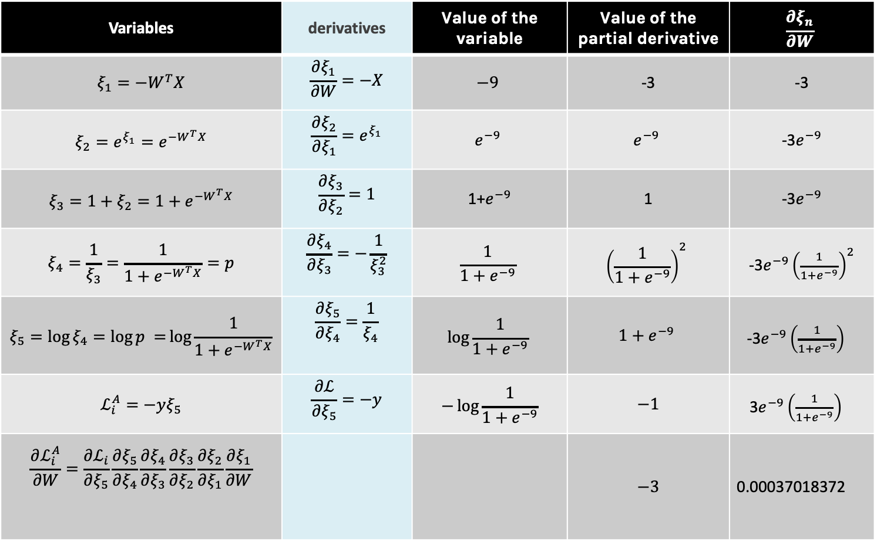
😱 BUT we still need to specify the derivatives 😱
Variables | derivatives | Value of the variable | Value of the partial derivative | $$\frac{∂ξ_{n}}{∂W}$$
$$ξ_{1}=−W^{T}X$$ | $$\frac{∂ξ_{1}}{∂W}=−X$$ | $$−9$$ | -3 | -3
$$ξ_{2}={e^{ξ_{1}}=e}^{−W^{T}X}$$ | $$\frac{∂ξ_{2}}{∂ξ_{1}}=e^{ξ_{1}}$$ | $$e^{−9}$$ | $$e^{−9}$$ | -3$e^{−9}$
$$ξ_{3}=1+ξ_{2}=1+e^{−W^{T}X}$$ | $$\frac{∂ξ_{3}}{∂ξ_{2}}=1$$ | 1+$e^{−9}$ | 1 | -3$e^{−9}$
$$ξ_{4}=\frac{1}{ξ_{3}}=\frac{1}{1+e^{−W^{T}X}}=p$$ | $$\frac{∂ξ_{4}}{∂ξ_{3}}=−\frac{1}{ξ_{3}^{2}}$$ | $$\frac{1}{1+e^{−9}}$$ | $${\left(\frac{1}{1+e^{−9}}\right)}^{2}$$ | -3$e^{−9}{\left(\frac{1}{1+e^{−9}}\right)}^{2}$
$$ξ_{5}=\log{ξ_{4}=\log{p =}\log{\frac{1}{1+e^{−W^{T}X}}}}$$ | $$\frac{∂ξ_{5}}{∂ξ_{4}}=\frac{1}{ξ_{4}}$$ | $$\log{\frac{1}{1+e^{−9}}}$$ | $$1+e^{−9}$$ | -3$e^{−9}{\left(\frac{1}{1+e^{−9}}\right)}^{}$
$$ℒ_{i}^{A}=−yξ_{5}$$ | $$\frac{∂ℒ}{∂ξ_{5}}=−y$$ | $$−\log{\frac{1}{1+e^{−9}}}$$ | $$−1$$ | 3$e^{−9}{\left(\frac{1}{1+e^{−9}}\right)}^{}$
$$\frac{∂ℒ_{i}^{A}}{∂W}=\frac{∂ℒ_{i}}{∂ξ_{5}}\frac{∂ξ_{5}}{∂ξ_{4}}\frac{∂ξ_{4}}{∂ξ_{3}}\frac{∂ξ_{3}}{∂ξ_{2}}\frac{∂ξ_{2}}{∂ξ_{1}}\frac{∂ξ_{1}}{∂W}$$ |  |  | $$−3$$ | 0.00037018372

Slide 16
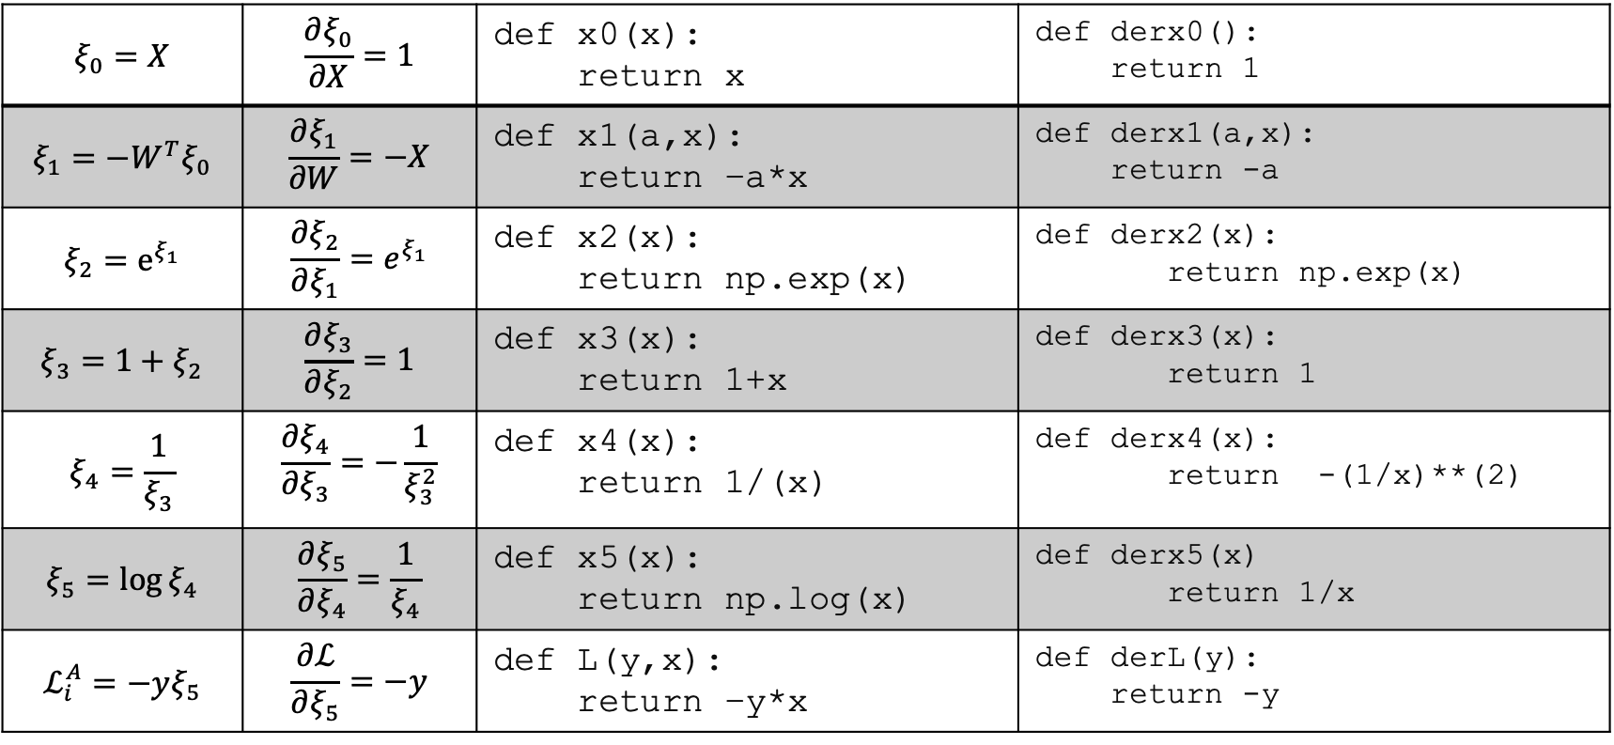
Notice though those are basic functions (simpleton functions) which are easy to code.
$$ξ_{0}=X$$ | $$\frac{∂ξ_{0}}{∂X}=1$$ | def x0(x): return x | def derx0(): return 1
$$ξ_{1}=−W^{T}ξ_{0}$$ | $$\frac{∂ξ_{1}}{∂W}=−X$$ | def x1(a,x): return –a*x | def derx1(a,x): return -a
$$ξ_{2}=e^{ξ_{1}}$$ | $$\frac{∂ξ_{2}}{∂ξ_{1}}=e^{ξ_{1}}$$ | def x2(x): return np.exp(x) | def derx2(x): return np.exp(x)
$$ξ_{3}=1+ξ_{2}$$ | $$\frac{∂ξ_{3}}{∂ξ_{2}}=1$$ | def x3(x): return 1+x | def derx3(x): return 1
$$ξ_{4}=\frac{1}{ξ_{3}}$$ | $$\frac{∂ξ_{4}}{∂ξ_{3}}=−\frac{1}{ξ_{3}^{2}}$$ | def x4(x): return 1/(x) | def derx4(x): return -(1/x)**(2)
$$ξ_{5}=\log{ξ_{4}}$$ | $$\frac{∂ξ_{5}}{∂ξ_{4}}=\frac{1}{ξ_{4}}$$ | def x5(x): return np.log(x) | def derx5(x) return 1/x
$$ℒ_{i}^{A}=−yξ_{5}$$ | $$\frac{∂ℒ}{∂ξ_{5}}=−y$$ | def L(y,x): return –y*x | def derL(y): return -y

Slide 17
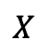
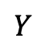
Putting it altogether
1. We specify the network structure
$$X$$
$$Y$$
2. Create a computational graph …

Slide 18
Computational Graph

Slide 19

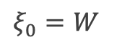
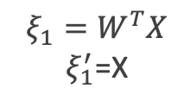
Computational Graph
$$ξ_{1}=W^{T}X$$ $ξ_{1}^{′}$=X
$$×$$
W
X
$$ξ_{0}=W$$

Slide 20

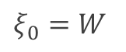

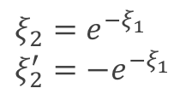
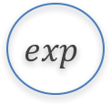
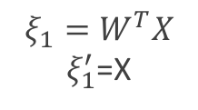
Computational Graph
$$exp$$
$$ξ_{2}=e^{−ξ_{1}} \\ ξ_{2}^{′}={−e}^{−ξ_{1}}$$
$$−$$
$$ξ_{1}=W^{T}X$$ $ξ_{1}^{′}$=X
$$×$$
W
X
$$ξ_{0}=W$$

Slide 21
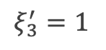
Computational Graph
$$ξ_{3}={1+e}^{−W^{T}X}$$
$$+$$
$$ξ_{3}^{′}=1$$
1
$$exp$$
$$ξ_{2}=e^{−ξ_{1}} \\ ξ_{2}^{′}={−e}^{−ξ_{1}}$$
$$−$$
$$ξ_{1}=W^{T}X$$ $ξ_{1}^{′}$=X
$$×$$
W
X
$$ξ_{0}=W$$

Slide 22
$$ξ_{5}=log{\frac{1}{1+e^{−W^{T}X}}}$$
Computational Graph
$$ξ_{4}=\frac{1}{1+e^{−W^{T}X}}$$
$$÷$$
Log
$$ξ_{7}=log(1−{\frac{1}{1+e^{−W^{T}X}})}$$
$$ξ_{3}={1+e}^{−W^{T}X}$$
$$+$$
log
-
1
$$exp$$
$$ξ_{6}=1−{\frac{1}{1+e^{−W^{T}X}}}$$
1-y
$$ξ_{2}=e^{−ξ_{1}} \\ ξ_{2}^{′}={−e}^{−ξ_{1}}$$
$$−$$
$$×$$
$$ξ_{1}=W^{T}X$$ $ξ_{1}^{′}$=X
y
$$×$$
$$×$$
$$ξ_{8}=\left(1−y\right)log(1−{\frac{1}{1+e^{−W^{T}X}})}$$
$$ξ_{9}=ylog({\frac{1}{1+e^{−W^{T}X}})}$$
W
X
$$+$$
$$ξ_{0}=W$$
$$−ℒ=ξ_{9}=ylog({\frac{1}{1+e^{−W^{T}X}})}+ \left(1−y\right)log(1−{\frac{1}{1+e^{−W^{T}X}})}$$

Slide 23
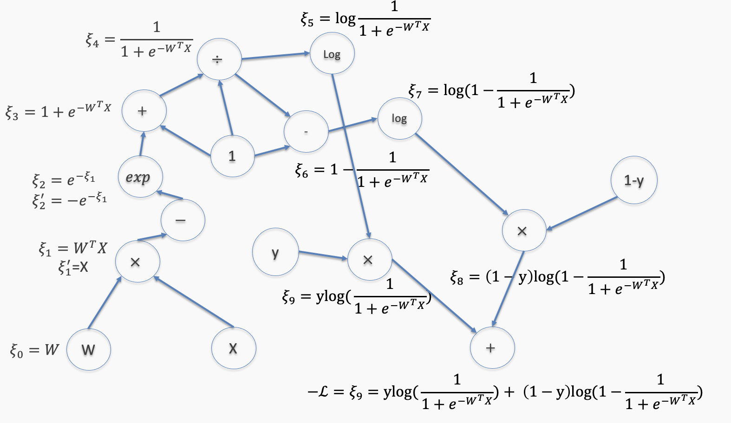
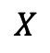
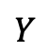
Putting it altogether
1. We specify the network structure
$$X$$
$$Y$$
2. Build the computational graph.
At each node of the graph, we build two functions: the evaluation of the variable and its partial derivative with respect to the previous variable (as shown in the table a few slides back)

Slide 24
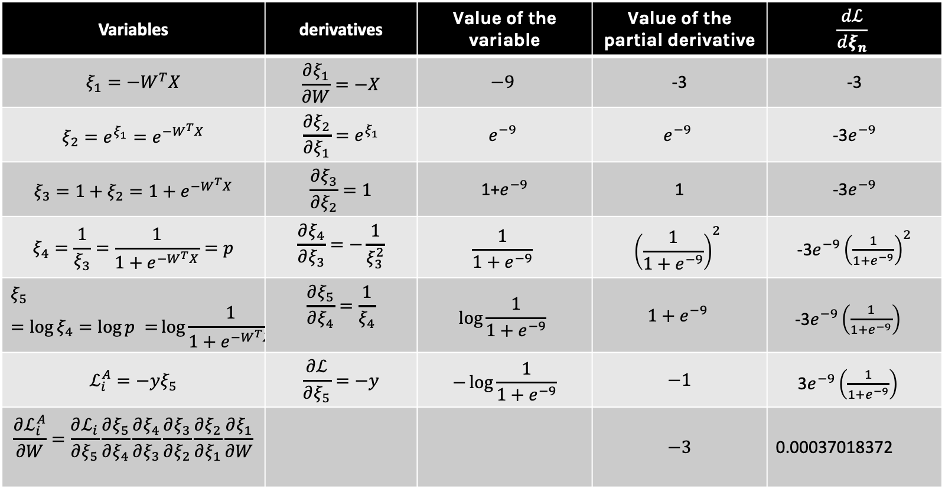
Forward mode: Evaluate the derivative at: X={3}, y=1, W=3
Variables | derivatives | Value of the variable | Value of the partial derivative | $$\frac{dℒ}{dξ_{n}}$$
$$ξ_{1}=−W^{T}X$$ | $$\frac{∂ξ_{1}}{∂W}=−X$$ | $$−9$$ | -3 | -3
$$ξ_{2}={e^{ξ_{1}}=e}^{−W^{T}X}$$ | $$\frac{∂ξ_{2}}{∂ξ_{1}}=e^{ξ_{1}}$$ | $$e^{−9}$$ | $$e^{−9}$$ | -3$e^{−9}$
$$ξ_{3}=1+ξ_{2}=1+e^{−W^{T}X}$$ | $$\frac{∂ξ_{3}}{∂ξ_{2}}=1$$ | 1+$e^{−9}$ | 1 | -3$e^{−9}$
$$ξ_{4}=\frac{1}{ξ_{3}}=\frac{1}{1+e^{−W^{T}X}}=p$$ | $$\frac{∂ξ_{4}}{∂ξ_{3}}=−\frac{1}{ξ_{3}^{2}}$$ | $$\frac{1}{1+e^{−9}}$$ | $${\left(\frac{1}{1+e^{−9}}\right)}^{2}$$ | -3$e^{−9}{\left(\frac{1}{1+e^{−9}}\right)}^{2}$
$$ξ_{5}=\log{ξ_{4}=\log{p =}\log{\frac{1}{1+e^{−W^{T}X}}}}$$ | $$\frac{∂ξ_{5}}{∂ξ_{4}}=\frac{1}{ξ_{4}}$$ | $$\log{\frac{1}{1+e^{−9}}}$$ | $$1+e^{−9}$$ | -3$e^{−9}{\left(\frac{1}{1+e^{−9}}\right)}^{}$
$$ℒ_{i}^{A}=−yξ_{5}$$ | $$\frac{∂ℒ}{∂ξ_{5}}=−y$$ | $$−\log{\frac{1}{1+e^{−9}}}$$ | $$−1$$ | 3$e^{−9}{\left(\frac{1}{1+e^{−9}}\right)}^{}$
$$\frac{∂ℒ_{i}^{A}}{∂W}=\frac{∂ℒ_{i}}{∂ξ_{5}}\frac{∂ξ_{5}}{∂ξ_{4}}\frac{∂ξ_{4}}{∂ξ_{3}}\frac{∂ξ_{3}}{∂ξ_{2}}\frac{∂ξ_{2}}{∂ξ_{1}}\frac{∂ξ_{1}}{∂W}$$ |  |  | $$−3$$ | 0.00037018372

Slide 25
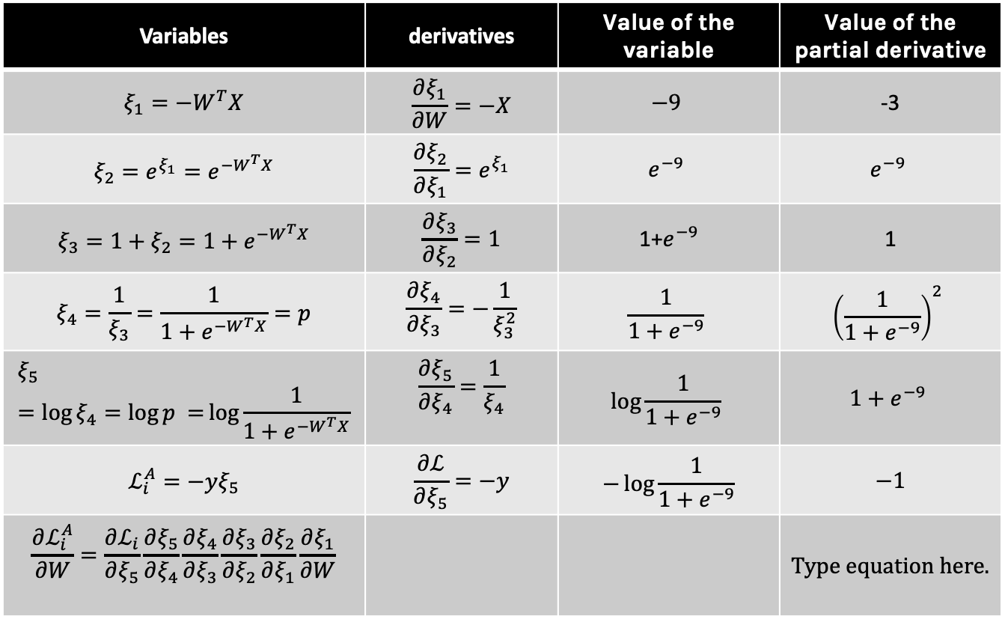
Backward mode: Evaluate the derivative at: X={3}, y=1, W=3
Variables | derivatives | Value of the variable | Value of the partial derivative
$$ξ_{1}=−W^{T}X$$ | $$\frac{∂ξ_{1}}{∂W}=−X$$ | $$−9$$ | -3
$$ξ_{2}={e^{ξ_{1}}=e}^{−W^{T}X}$$ | $$\frac{∂ξ_{2}}{∂ξ_{1}}=e^{ξ_{1}}$$ | $$e^{−9}$$ | $$e^{−9}$$
$$ξ_{3}=1+ξ_{2}=1+e^{−W^{T}X}$$ | $$\frac{∂ξ_{3}}{∂ξ_{2}}=1$$ | 1+$e^{−9}$ | 1
$$ξ_{4}=\frac{1}{ξ_{3}}=\frac{1}{1+e^{−W^{T}X}}=p$$ | $$\frac{∂ξ_{4}}{∂ξ_{3}}=−\frac{1}{ξ_{3}^{2}}$$ | $$\frac{1}{1+e^{−9}}$$ | $${\left(\frac{1}{1+e^{−9}}\right)}^{2}$$
$$ξ_{5}=\log{ξ_{4}=\log{p =}\log{\frac{1}{1+e^{−W^{T}X}}}}$$ | $$\frac{∂ξ_{5}}{∂ξ_{4}}=\frac{1}{ξ_{4}}$$ | $$\log{\frac{1}{1+e^{−9}}}$$ | $$1+e^{−9}$$
$$ℒ_{i}^{A}=−yξ_{5}$$ | $$\frac{∂ℒ}{∂ξ_{5}}=−y$$ | $$−\log{\frac{1}{1+e^{−9}}}$$ | $$−1$$
$$\frac{∂ℒ_{i}^{A}}{∂W}=\frac{∂ℒ_{i}}{∂ξ_{5}}\frac{∂ξ_{5}}{∂ξ_{4}}\frac{∂ξ_{4}}{∂ξ_{3}}\frac{∂ξ_{3}}{∂ξ_{2}}\frac{∂ξ_{2}}{∂ξ_{1}}\frac{∂ξ_{1}}{∂W}$$
Store all these values
Multiply as needed

Slide 27


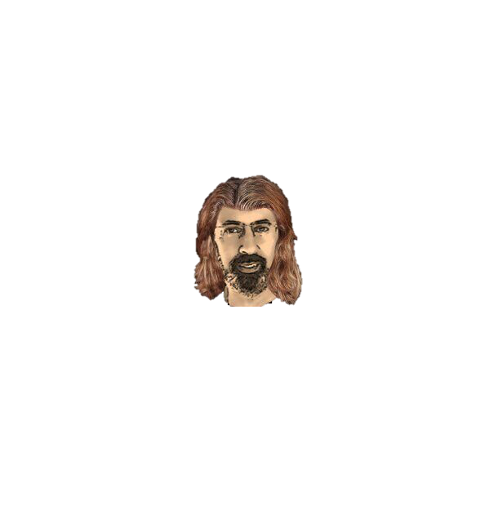


Thank you

